Slide 1
Mobile Computing II (TSI354)
Pertemuan IV :
Material Design
Oleh: M. Priyono Tri Sulistyanto, S.T., M.Eng

Slide 2
Pokok Bahasan Kuliah
Layout Lanjut
Pemrograman Layout Dinamis
Aturan layout UI Android
Material Design
Aplikasi Database Lanjut
Akses ke Database Server
Web-service dengan JSON
Aplikasi Game
Import Game Engine Library
Pemrograman dengan game engine
Pemrograman untuk akses hardware
Akselerometer, Kompas, GPS
Telepon
Bluetooth
Wifi
Kamera
Pemrograman SMS
Aplikasi mobile tingkat lanjut
Mobile Computing II (Sistem Informasi)
2

Slide 3
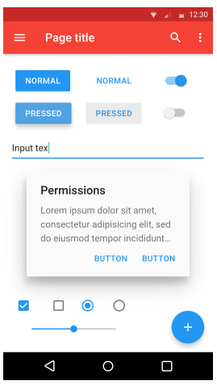
Material Design (intro)
Material Design merupakan bahasa desain yang dikembangkan oleh Google. (mulai Android v5.0+)
Desain menerapkan peningkatan penggunaan berbasis grid, anismasi responsif, tansisi, padding, efek kedalaman, pencahayaan dan bayangan.
Sumber: https://www.google.com/design/spec/material-design/introduction.html
Mobile Computing II (Sistem Informasi)
3

Slide 4
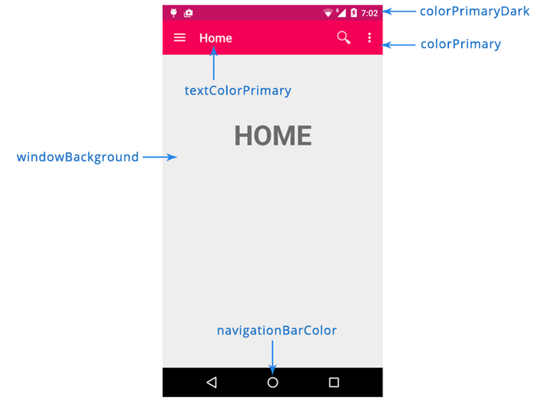
Pemilihan warna Material Design
Material Design menyediakan kumpulan properti untuk memilih warna dalam Material Design . Berikut 5 atribut utama utk :
colorPrimaryDark: warna utama paling gelap yang diaplikasikan pada latar belakang notification bar
colorPrimary: warna utama app
textColorPrimary: warna utama teks
windowBackground: warna latar belakang default app
navigationBarColor: warna latar belakang dari navigation bar bawah
Mobile Computing II (Sistem Informasi)
4

Slide 5
Pembuatan aplikasi
Membuat proyek Android dengan kompability minSDK=8 maxSDK=21
Tambah colors.xml di folder res/values:
01 | import android.app.Activity;
02 | import android.os.Bundle;
03 | import android.view.Menu;
04 | import android.view.MenuItem;
05 | public class MainActivity extends Activity {
06
07 | @Override
08 | protected void onCreate(Bundle savedInstanceState) {
09 | super.onCreate(savedInstanceState);
10 | setContentView(R.layout.activity_main);
11
12 | }
13 | }
01 | <?xml version="1.0" encoding="utf-8"?>
02 | <resources>
03
04 | <color name="colorPrimary">#F50057</color>
05 | <color name="colorPrimaryDark">#C51162</color>
06 | <color name="textColorPrimary">#FFFFFF</color>
07 | <color name="windowBackground">#FFFFFF</color>
08 | <color name="navigationBarColor">#000000</color>
09 | <color name="colorAccent">#FF80AB</color>
10
11 | </resources>
Mobile Computing II (Sistem Informasi)
5

Slide 6
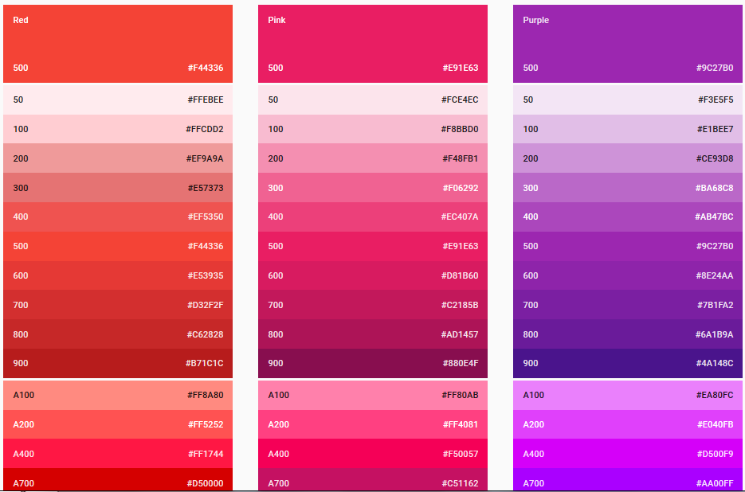
Palet warna dasar (http://www.google.com/design/spec/style/color.html#color-color-palette)
Mobile Computing II (Sistem Informasi)
6

Slide 7
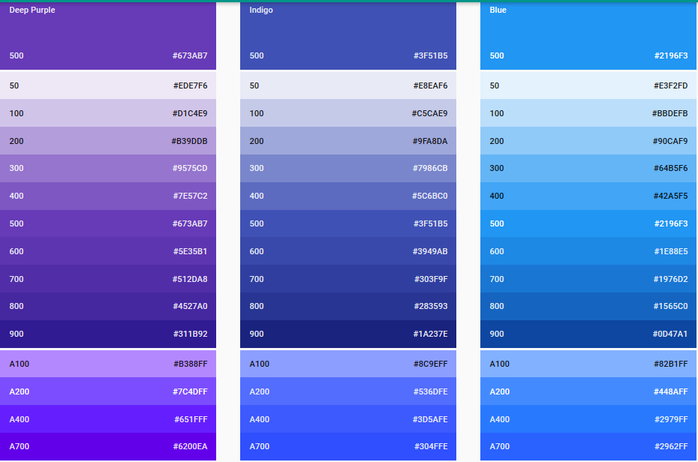
Palet warna dasar (http://www.google.com/design/spec/style/color.html#color-color-palette)
Mobile Computing II (Sistem Informasi)
7

Slide 8
Membuat tema Material Design
Edit file styles.xml di folder res/values:
01 | <resources>
02
03 | <!--
04 | Base application theme, dependent on API level. This theme is replaced
05 | by AppBaseTheme from res/values-vXX/styles.xml on newer devices.
06 | -->
07 | <style name=“MyAppBaseTheme" parent="Theme.AppCompat.Light.DarkActionBar">
08 | <!--
09 | Theme customizations available in newer API levels can go in
10 | res/values-vXX/styles.xml, while customizations related to
11 | backward-compatibility can go here.
12 | -->
13
14 | <item name="windowActionBar">true</item>
15 | <item name="colorPrimary">@color/colorPrimary</item>
16 | <item name="colorPrimaryDark">@color/colorPrimaryDark</item>
17 | <item name="colorAccent">@color/colorAccent</item>
18 | </style>
19
20 | <!-- Application theme. -->
21 | <style name=“MyAppTheme" parent=“MyAppBaseTheme">
22 | <!-- All customizations that are NOT specific to a particular API-level can go here. -->
23 | </style>
24
25 | </resources>
Mobile Computing II (Sistem Informasi)
8

Slide 9
Membuat tema Material Design
Ubah AndroidManifest.xml :
01 | <?xml version="1.0" encoding="utf-8"?>
02 | <manifest xmlns:android="http://schemas.android.com/apk/res/android"
03 | package="com.example.matdesign4"
04 | android:versionCode="1"
05 | android:versionName="1.0" >
06
07 | <uses-sdk
08 | android:minSdkVersion="8"
09 | android:targetSdkVersion="21" />
10
11 | <application
12 | android:allowBackup="true"
13 | android:icon="@drawable/ic_launcher"
14 | android:label="@string/app_name"
15 | android:theme="@style/MyAppTheme" >
16 | <activity
17 | android:name=".MainActivity"
18 | android:label="@string/app_name" >
19 | <intent-filter>
20 | <action android:name="android.intent.action.MAIN" />
21
22 | <category android:name="android.intent.category.LAUNCHER" />
23 | </intent-filter>
24 | </activity>
25 | </application>
26
27 | </manifest>
Mobile Computing II (Sistem Informasi)
9

Slide 10
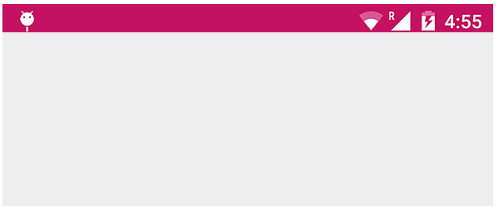
Membuat tema Material Design
Dalam folder res/ buat folder values-v21, kemudian buat file styles.xml yang lain:
Screenshot:
01 | <?xml version="1.0" encoding="utf-8"?>
02 | <resources>
03
04 | <style name="AppTheme" parent="AppBaseTheme">
05 | <item name="android:windowContentTransitions">true</item>
06 | <item name="android:windowAllowEnterTransitionOverlap">true</item>
07 | <item name="android:windowAllowReturnTransitionOverlap">true</item>
08 | <item name="android:windowSharedElementEnterTransition">@android:transition/move</item>
09 | <item name="android:windowSharedElementExitTransition">@android:transition/move</item>
10 | </style>
11
12 | </resources>
Mobile Computing II (Sistem Informasi)
10

Slide 11
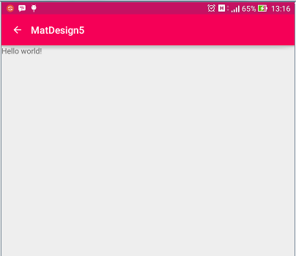
Menambah ActionBar
Ubah file MainActivity.java dengan mengganti kelas Activity menjadi kelas AppCompatActivity:
01 | public class MainActivity extends AppCompatActivity {
02
03 | @Override
04 | protected void onCreate(Bundle savedInstanceState) {
05 | super.onCreate(savedInstanceState);
06 | setContentView(R.layout.activity_main);
07
08 | ActionBar mBar = getSupportActionBar();
09 | mBar.setDisplayHomeAsUpEnabled(true);
10 | }
11
12 | @Override
13 | public boolean onCreateOptionsMenu(Menu menu) {
14 | // TODO Auto-generated method stub
15 | return super.onCreateOptionsMenu(menu);
16 | }
17
18 | @Override
19 | public boolean onOptionsItemSelected(MenuItem item) {
20 | // TODO Auto-generated method stub
21 | return super.onOptionsItemSelected(item);
22 | }
23 | }
Mobile Computing II (Sistem Informasi)
11

Slide 12
Menambah Menu Icon
Tambah file main_menu.xml di folder res/menu/:
Ubah method onCreateOptionMenu() untuk menampilkan menu dan ikon di MainActivity.java:
01 | <?xml version="1.0" encoding="utf-8"?>
02 | <menu xmlns:android="http://schemas.android.com/apk/res/android"
03 | xmlns:app="http://schemas.android.com/apk/res-auto"
04 | xmlns:tools="http://schemas.android.com/tools"
05 | tools:context="com.example.matdesign4.MainActivity" >
06
07 | <item
08 | android:id="@+id/action_settings"
09 | android:orderInCategory="100"
10 | android:title="Setting"
11 | app:showAsAction="never"/>
12 | <item
13 | android:id="@+id/action_search"
14 | android:icon="@drawable/abc_ic_search_api_mtrl_alpha"
15 | android:orderInCategory="100"
16 | android:title="Search"
17 | app:showAsAction="always"/>
18 | </menu>
12 | @Override
13 | public boolean onCreateOptionsMenu(Menu menu) {
14 | // TODO Auto-generated method stub
15 | getMenuInflater().inflate(R.menu.main_menu, menu);
16 | return super.onCreateOptionsMenu(menu);
17 | }
Mobile Computing II (Sistem Informasi)
12

Slide 13
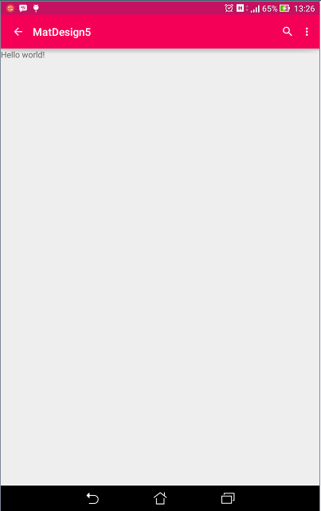
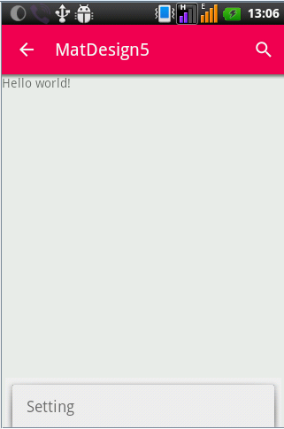
Screenshot akhir:
Di tablet Asus Fonepad (Android v.5.0.1)
Di LG P698 (Android v.2.3.4)
Mobile Computing II (Sistem Informasi)
13

Slide 14
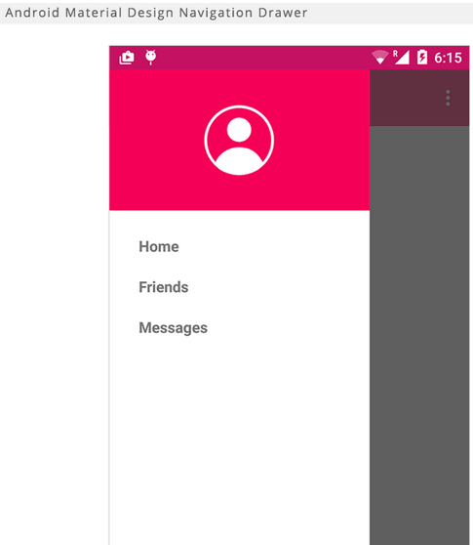
Pengembangan Lebih Lanjut:
Navigation Drawer: Menu tersembunyi yang diaktifkan dengan cara swipe(mengusap) sisi kiri layar
Mobile Computing II (Sistem Informasi)
14

